Slide 1
Decalcification

Slide 2
Decalcification
It is the process of removal calcium salts Even from the bone and calcified tissues naturally or due to some disease by suitable method according the specimen, time and the equipment.
*Calcium salts should be removed (Why?)
a)it is difficult to end up with a satisfactory section.
b) if calcium salts not removed. Knives will be destroyed.

Slide 3
fixation
Tissue must be fixed adequately before decalcification.
The selected bone is placed in 10% neutral buffered formalin for 24-48h
- Bone marrow is best fixed in zenker’s fluid

Slide 4
The criteria of a good decalcifying agent
1.Complete removal of calcium salts.
2.Absence of damage to tissue, cells, fibers or other constituents.
3.Non-impairing of subsequent staining.
4.Reasonable speed of decalcification

Slide 5
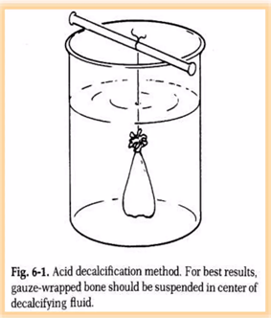
The process of decalcification
1-The selection of the tissue cut in to small pieces 3-5mm
2. Adequate or complete fixation of the tissue blocks.
3. Decalcification using the decalcifying solution.
4. Testing the end point of decalcification to get sure that it is complete (removal of calcium salts).
5. Neutralization of the acid for 12-18 hours using 5%
lithium or sodium sulphate or by washing in running water.
6. Washing in running tap water to remove the alkaline solutions used for neutralization to avoid interfering with staining

Slide 6
Factors affecting rate of Decalcification
1.Concentration of decalcifying solution-Increased concentration of the decalcifying agent fastens the reaction.
2. Temperature-
The rate of decalcification increases with rise of temperature.
3. Density of bone-Harder bone takes longer time to decalcify.
4. Thickness of the tissue-Small tissue pieces decalcify earlier.
5. Agitation- Agitation increases the rate of decalcification

Slide 7
Methods of decalcification
1- Simple dilute mineral acids:
a-Weak acid.
b. Strong acid.
2-Electrolytic decalcification
3-lon exchange resins with acid decalcifying fluids
4- Chelating agents
5- surface decalcification

Slide 8
1- Simple dilute mineral acids
this method of decalcification dissolves the calcium salts in an acid solution called decalcifying fluids used either singly or mixture such as nitric acid, formic acid and trichloroacetic acid.

Slide 9
-Aqueous Nitric acid
(Inorganic acid)Nitric acid solution (5ml)., distilled water100ml
-Is strong acid
small pieces of tissue )) - Good for Nuclear staining
-Used in urgent biopsy specimens
Disadvantage:
-Nitric acid cause yellow coloration of tissue, treated by using 1% urea.(transfer tissues directly to 70% alcohol).
-tissue in long period in solution cause damaged

Slide 10
-Nitric acid formaldehyde
-Nitric acid 10ml,formalin 5-10ml, distilled water 100ml
-Advantage :
-Rapid action
-good nuclear staining
- Formalin protect the tissue from maceration

Slide 11
-Formic acid solution
-Formic acid 5ml, distilled water 90ml, formalin 5ml
-Decalcified slow
- become fasted when the concentration increased more, But damage occur

Slide 12
Trichloroacetic Acid
-For small biopsy
- its slow
- can not used for dense bone or big bone or tissues

Slide 13
2-The lon-Exchange
-Ammonium salt of sulfonate polystyrene resin
-formic acid
-x-ray
-Advantages
-faster
-well preserve tissue structures
-longer use for resin

Slide 14
3- Electrolytic decalcification
-There are using a(+ve) and (-ve) electrons.
-The bone is raped by a platinum wire which is the cathode
-the anode is form of carbon wire.
-The decalcifying solution consist of equal parts of 80% formic acid & 10% HCL acting as electrolyte with 6 volts for (1hrs).
-When the current passed, calcium will be removed
to the anode and the temprature will rise up to (30-45)C.
-rapid calcification is occur , heat produced damage to the cytological details.

Slide 15
4- Chelating agents
-Chelating agents are organic compounds that are capable of binding with certain metals.
-They are typically very slow acting and gentle, making them good fixatives for electron -microscopy and immunohistochemistry studies.

Slide 16
4- Chelating agents
Ethylene diamine tetraacetic acid (EDTA) is the most common chelating agent used for decalcification. It binds with calcium ions and gradually removed.
*Care should be taken when specimens contain cartilage because overexposure can remove proteoglycans and weaken staining

Slide 17
Advantages:
-Tissue isn't hardened after EDTA decalcification.
-The tissue easier to cut by microtome.
-Some enzymes are still active.
-best for cancerous bone
-best for bone marrow biopsy( preserve cytological details and glycogen of bone marrow).

Slide 18
5- surface decalcification
-The surface layer of paraffin blocks are inverted in 5% HCL for 1hr.
-above top 30 micron is decalcified.
-should be washed thoroughly before cutting

Slide 19
Neutralization
-Various neutralizing treatments used after acid decalcification including:
1.Overnight washing in tap water or other alkaline solution and washing in the changes of 70% alcohol for (12-18)hrs before continuing the dehydration process. This is to remove any acid
2. For frozen sectioning should be washed in water or stored in formal saline before being Frozen.

Slide 20
End-Point
End-Point of Decalcification There are several methods for testing the completion decalcification:
1-Radiological method.
2-Physical method.
3-Chemical method.

Slide 21
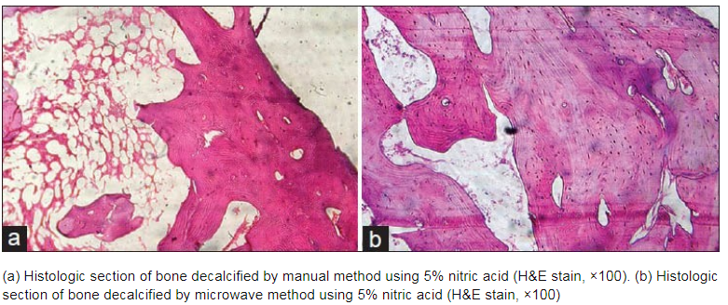

Slide 22
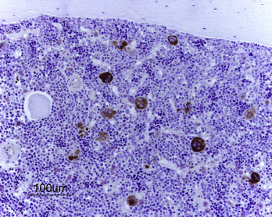
Paraffin section of a rat bone, initially fixed with Zn-formaldehyde solution and decalcified with EDTA .Note the positively stained megakaryocytes in the bone marrow. Bar=100 µm.

Slide 23
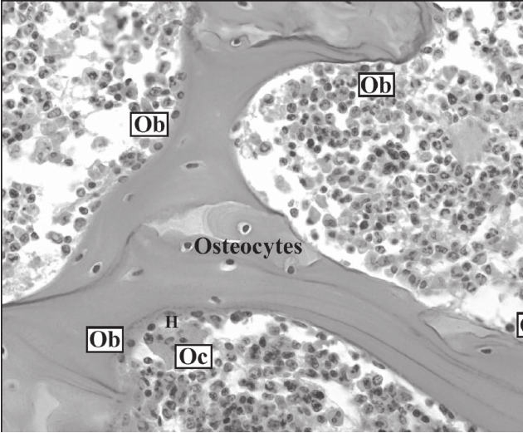
Decalcified section (400x magnification) showing the bone cells; osteoblasts (Ob) and osteoclast (Oc) which lying on the trabecular bone surface.

Slide 24
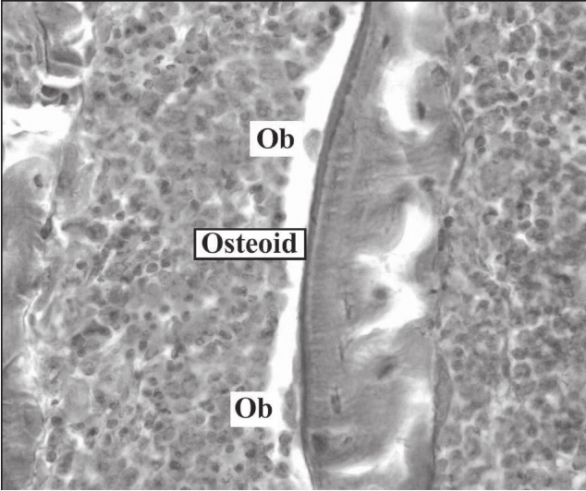
Osteoid clearly demonstrated in un decalccified section zone between a layer of active osteoblasts (Ob) and the mineralized zone (400 x magnification). Masson Goldner stain.

Slide 25
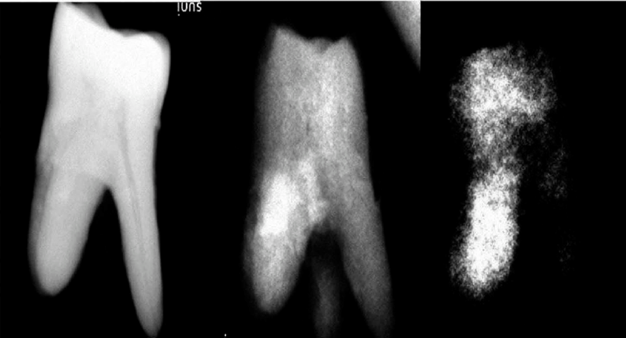
Radiograph showing end point determination of decalcification of teeth

Slide 26


